Slide 1
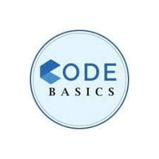


Telangana Growth analysis
BY SOUVIK SASMAL

Slide 2

CONTENTS
INSIGHTS TO ACTIONS
STAMP REGISTRATION ANALYSIS
TRANSPORT SALES ANALYSIS
TS – IPASS ANALYSIS
SECONDARY RESEARCH
ANALYSIS EPILOGUE
ACKNOWLEDGEMENTS

Slide 3
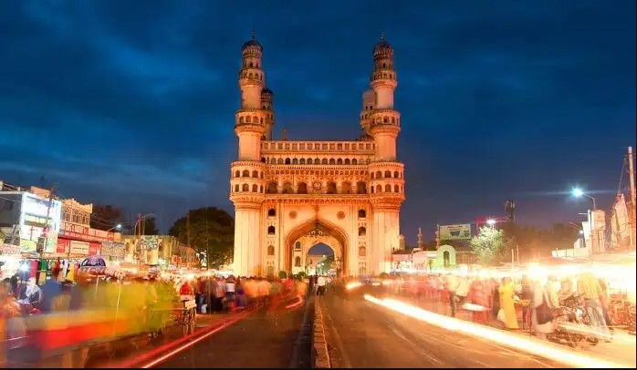
INSIGHTS TO ACTIONS
Let's dive into today's topic. I've undertaken a thorough data analysis of Telangana's growth across multiple sectors using PowerBI. The insights generated are tailored for top-level management and aim to provide a data-driven pathway for the state's future development. I'm excited to share these results with you

Slide 4
Stamp registration analysis
Performed analysis on the revenue derived from both document registrations and e-stamp challan payments, breaking it down by district and month. The stamp registration analysis involves examining the records of property transactions to assess trends, identify tax compliance, and gauge the real estate market's health. It provides critical insights into property values, market dynamics, and tax revenue, aiding government policies and investment decisions.

Slide 5
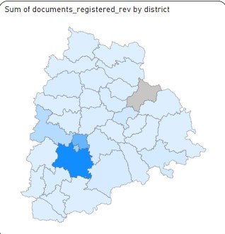
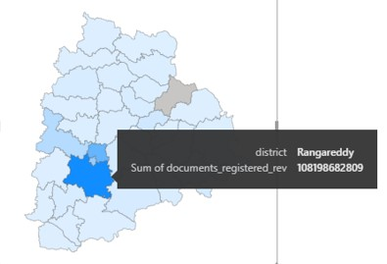
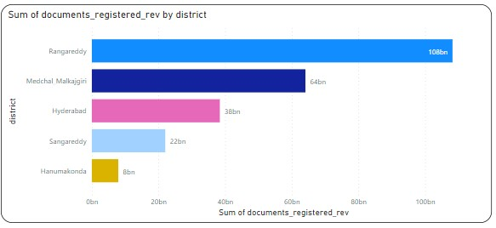
Document registration analysis
The revenue generated from document registration varies significantly across districts in Telangana
Rangareddy have generated high revenue of Rs. 108.19Bn and Kumurambheem Asifabad generating the lowest revenue of Rs. 227M
After analyzing the data, here are the top 5 districts that showed the highest document registration revenue growth between Fiscal Year (FY) 2019 and FY 2022: Rangareddy (108bn), A Hydreabad(58bn), Sangareddy (22bn), Medchal_Malkajgiri (64bn)

Slide 6
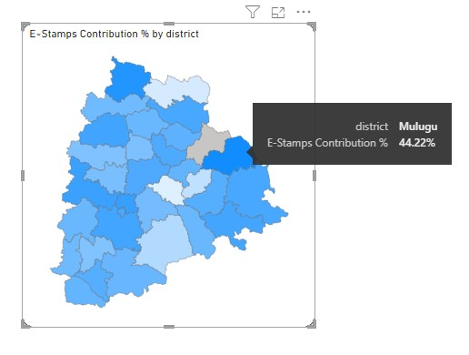
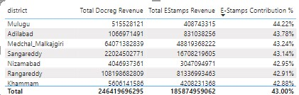
Comparison of revenue
The revenue generated from document registration and e-stamp challans varies among districts, but in some districts Rangareddy, Hyderabad, Khammam, Hanumakonda, Yadadri Bhuvanagiri, Alidabad etc..
e-stamp challan revenue has overtaken document registration revenue in FY 2022, by calculating e-stamp contribution % , indicating a significant trend or shift in revenue generation specially in mulungu which is 44.22%

Slide 7
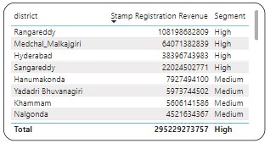
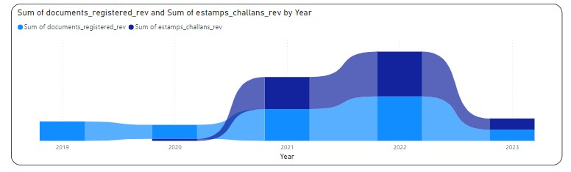
Impact of e-stamp challan
Categorize districts into three segments based on their stamp registration revenue generation during the fiscal year 2021 to 2022.
From the above table we got that Rangareddy , Medcal, Hydreabad have the highest segments
The data reveals a noticeable shift in the pattern of document registration and e-Stamp challan counts since the implementation of e-Stamp challans

Slide 8
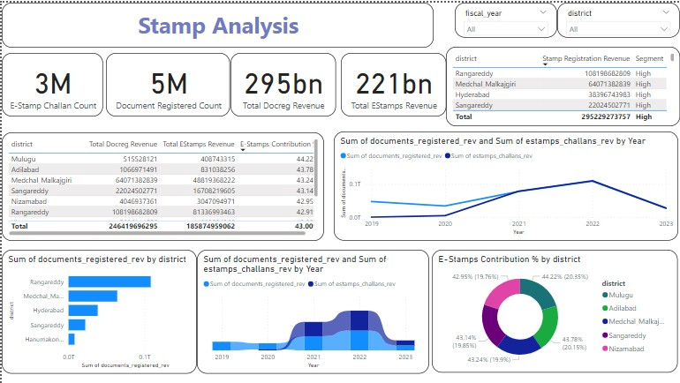

Slide 9
Transport Sales Analysis
Performed analysis on Telangana's RTA vehicle sales data, categorized by factors like fuel type and seating capacity, and aggregate it by district and month.I conducted an analysis on Telangana's RTA vehicle sales data, categorizing it based on factors such as fuel type and seating capacity. I then aggregated this data by district and month. This comprehensive analysis offers valuable insights into regional vehicle preferences and market dynamics, aiding in strategic decision-making for the automotive sector and transportation planning.

Slide 10
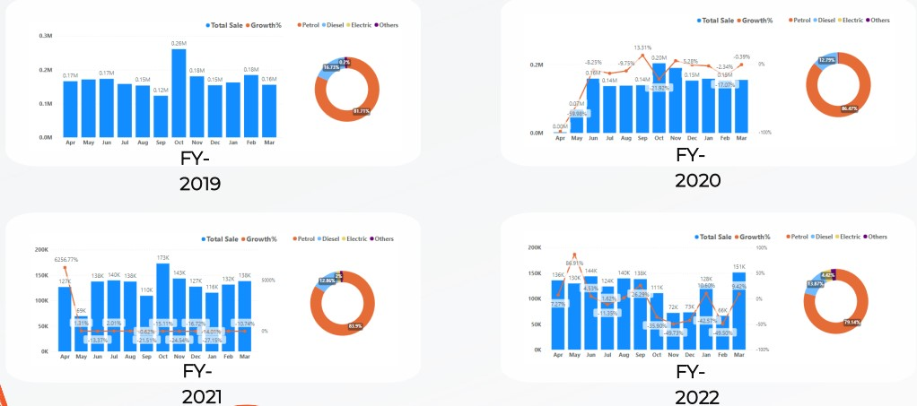
Seasonal Fuel sales correlaton
The bar plots below show the monthly sales trends for total vehicle sale considering fuel types across various fiscal years. We can see that every year Oct have generated the highest sale which is due to high discounts and festive offers. Apr 2020 have seen the lowest sale of all time due to Covid-19 which increased gradually till the month of Oct

Slide 11
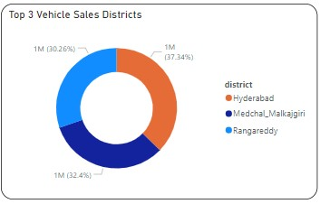
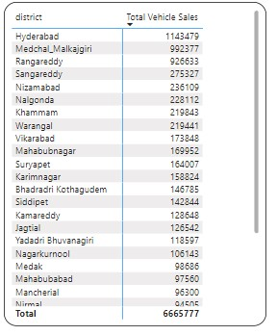
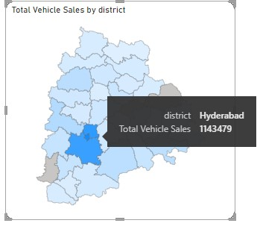
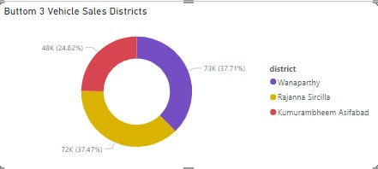
District Fuel sales correlaton
Hyderabadis consistently the highest seller across all fiscal years, making it a critical market.
Medchal_Malkajgiri and Rangareddy are consistently high-performing districts, coming in second and third respectively across all fiscal years.
Kumurambheem Asifabad consistently shows the lowest sales, which might need investigation into possible causes and potential for improvement.

Slide 12
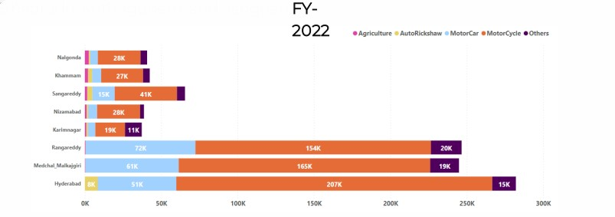
District vehicle sales correlation
The bar plots below show the districts wise sales trends considering vehicle class across various fiscal years 2022.
• Motorcycles are the most commonly sold vehicle class in almost all districts. The sales of motorcycles are significantly higher than those of other vehicle classes
• The sales of motorcars vary significantly across districts. For instance, Hyderabad has a considerably higher number of motorcar sales compared to other districts
• AutoRickshaw & Agriculture are relatively smaller but show some district-specific trends. For example, AutoRickshaws have higher sales in Hyderabad, while Agriculture-related vehicles see higher sales

Slide 13
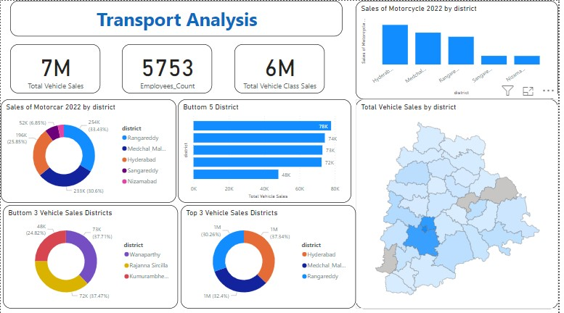

Slide 14
TS-ipass analysis
I've analyzed Telangana's TS-iPASS dataset, a government initiative aimed at simplifying project approvals to boost industrial growth. The analysis uncovers significant trends in investments across diverse sectors and throughout different months. These insights can inform policy decisions, economic planning, and investment strategies, contributing to the state's industrial development and economic growth.

Slide 15
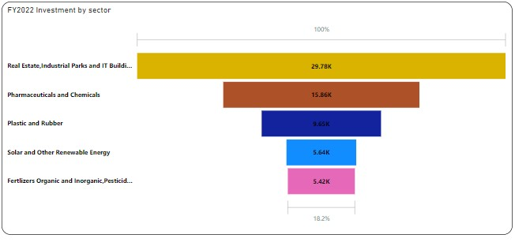
Top sectors for investment
The top 5 sectors that have witnessed the most significant investments in FY 2022 are as:
1. Plastic and Rubber: Sector with the highest investment of ₹ 58.5Bnin FY 2022
2. Pharmaceuticals and Chemicals: Second highest investment of ₹ 21.81Bn in FY 2022
3. Real Estate, Industrial Parks and IT Buildings: Investment of ₹ 21.27Bnin FY 2022
4. Solar and Other Renewable Energy: Another fast-growing sector with investment of ₹ 20.52Bn in FY 2022
5. Engineering: Invest of ₹ 18.77Bnin FY 2022

Slide 16
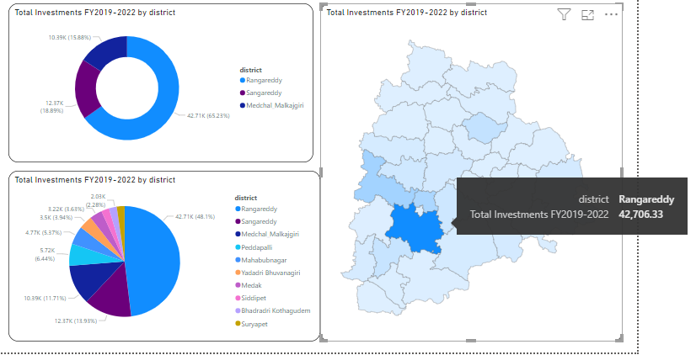
Investment across top districts
The top districts that have attracted the most significant sector investments during FY 2019 to 2022 are:

Slide 17
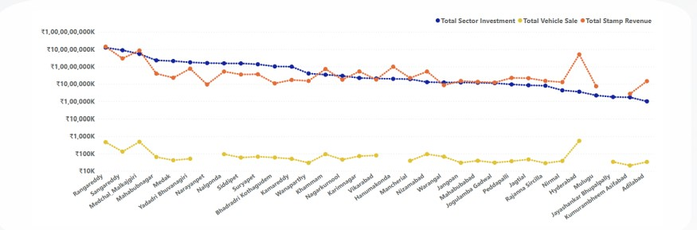
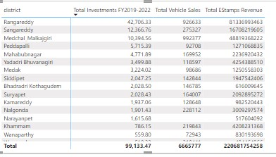
Comparison of revenue in all sectors

Slide 18
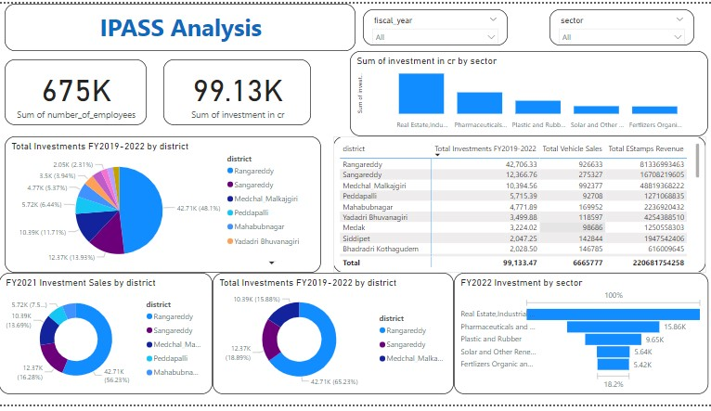

Slide 19
Secondary research
We have utilized data from Telangana Industries TS-iPASS for our secondary research and analysis, enabling a deeper and more comprehensive understanding of the varied industrial sectors within the region

Slide 20
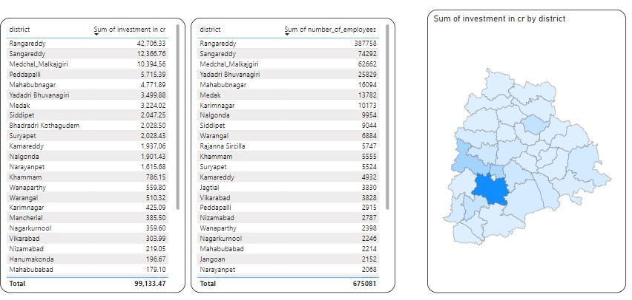
Districts to buy commercial purposes
The Districts to buy commercial purposes are sorted as follows:

Slide 21
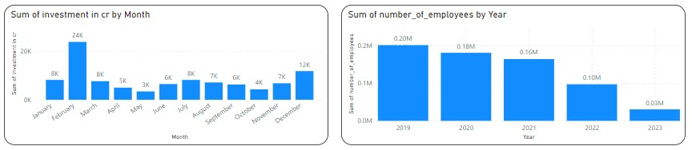
Polices of Government impacts
Investment and Employment Trends Over Years
Investment: The graph shows a consistent trend in investment over the years, suggesting that the investment climate is favorable. This could be attributed to various government policies aimed at encouraging business activities.
Employment: Similar to investment, the number of employees also shows a steady trend. This indicates that employment opportunities are increasing, possibly due to government initiatives aimed at job creation.

Slide 22
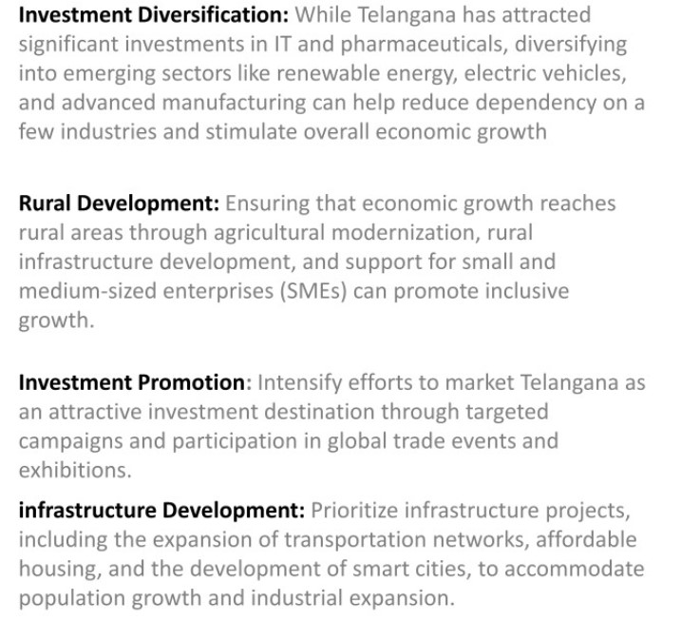
top 2 Insights & 2 recommendations to Telangana government

Slide 23
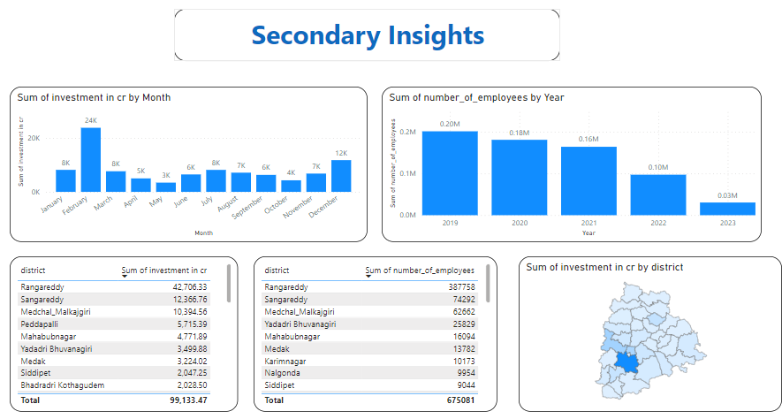

Slide 24

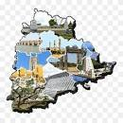
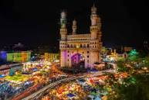
Thank You
Name – Souvik Sasmal
Gmail - sasmalsouvik333@gmail.com
LinkedIn - www.linkedin.com/in/souvik-sasmal-010a1320b
GitHub - github.com/souviksas2001

